Slide 1

Explainable AI (XAI)
Kisejjere Rashid | DataProducts Fellow

Slide 2

Pollicy is an award-winning feminist collective of technologists, data scientists, creatives and academics working at the intersection of data, design and technology to craft better life experiences by harnessing improved data. Our work focuses on influencing a culture of responsible data use, promoting appropriate data governance practices and advocating for policies that support an enabling data ecosystem.
About Pollicy

Slide 3
Objectives of this session
We will be introduced to key concepts on explainable AI and a few examples in our context.

Slide 4
Overview
Introduction
Interpretable ML (Practical)
LIME (Practical)
SHAP(Practical)
NB. Basic Understanding of ML, Algebra and Python is a plus for this session

Slide 5

Interpretability and Explainability of AI
Explainability - Model behaviour is explained in human
Terms mainly used in Model agnostic methods.
Interpretability - High Model transparency and understanding of exactly why and how the model comes up with a prediction.

Slide 6
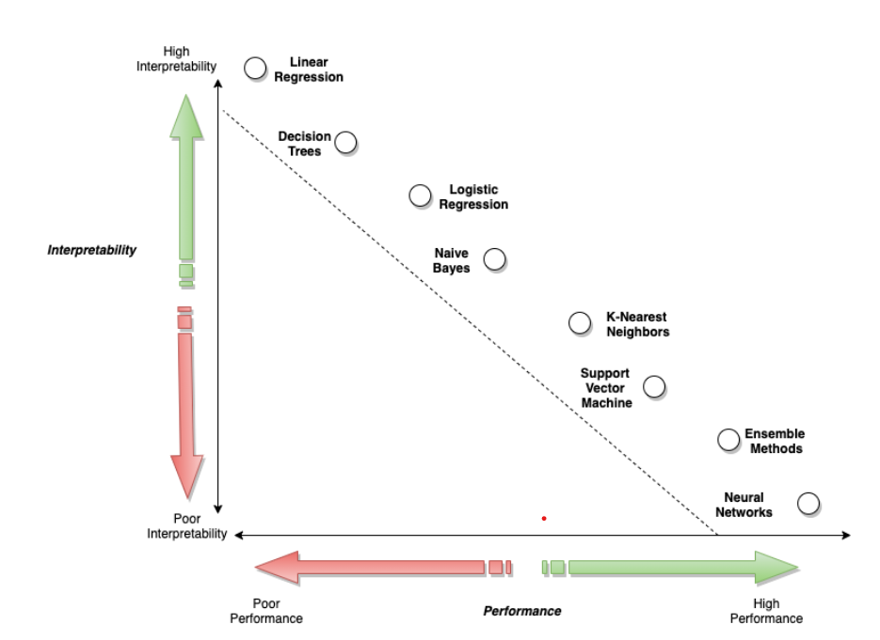

Slide 7
Understanding Machine learning Models
WHITE BOX APPROACH
BLACK BOX APPROACH
Understand the Model weights
Use the input output relationships

Slide 8
XAI Categorization
Agnosticity
Scope
Data Type
Explainability type

Slide 9
Agnosticity
Model Agnostic
Model Specific

Slide 10
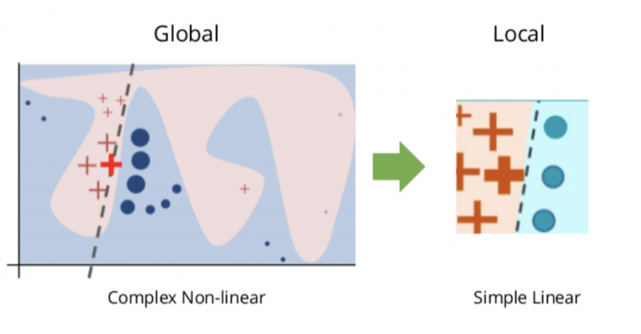
Scope
explaining specific instances of input and associated model output
explain the model and its parameters as a whole

Slide 11
Data Type
Graph
Image
Tabular
Text
Audio

Slide 12
Explainability Type
Visual
Feature Importance
Data points
Surrogate Models

Slide 13
Interpretable ML Models
Linear Regression
Decision Tree
Explainable Boosting Machines

Slide 14
Interpretable ML (Practical part)
Link - https://colab.research.google.com/drive/1GWbYNdKbYHy0ThrUbUEupdnpjHTwURlr

Slide 15
LIME
LIME - Local Interpretable Model agnostic Explanations
2016 paper - “WHY SHOULD I TRUST YOU” ([1602.04938] "Why Should I Trust You?": Explaining the Predictions of Any Classifier (arxiv.org))

Slide 16
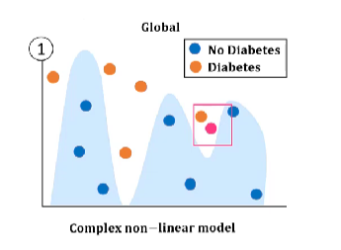
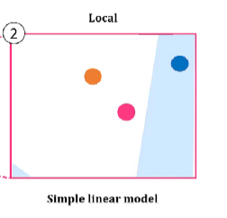
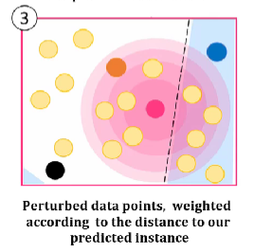
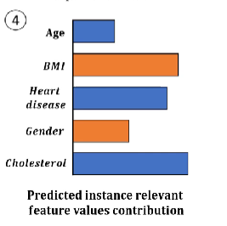
Steps of LIME
To be explained point

Slide 17
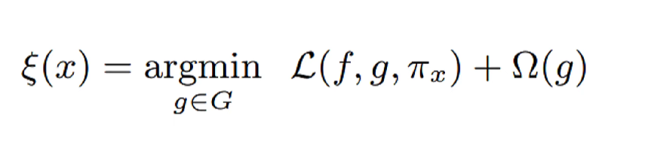

Math in LIME
Good approximation
Regularization
Proximity
Interpretable models family
Simple Interpretable model
Complex model
X =

Slide 18
Practical part
Link - https://colab.research.google.com/drive/1GWbYNdKbYHy0ThrUbUEupdnpjHTwURlr

Slide 19
SHAP
SHapely Additive exPlanations
Based on the Shapely Values in Game theory by Lloyd Shapely. (https://en.wikipedia.org/wiki/Shapley_value)

Slide 20



Explanation

Slide 21


Explanation

Slide 22

Explanation

Slide 23

Explanation

Slide 24
SHAP
Features
AGE
BMI
HEART DISEASE
GENDER
CHOLESTEROL

Slide 25
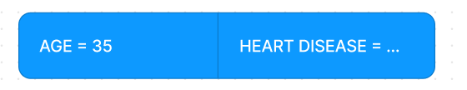
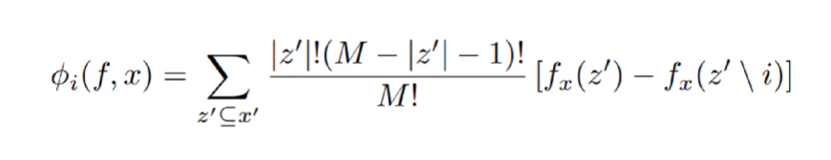

SHAP Math
Black Box Mode
AGE
Data point
Sub set values
Shapely Value of a given feature i
X =

Slide 26
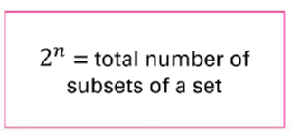
SHAP Calculations
Kernel SHAP
Deep SHAP
Tree SHAP
Given n = 10 features, 1024 computations per feature

Slide 27
SHAP Practical Part
Link - https://colab.research.google.com/drive/1GWbYNdKbYHy0ThrUbUEupdnpjHTwURlr

Slide 28
Conclusion
Concluding Remarks

Slide 29

Any supplements?

Slide 30
THANK YOU FOR LISTENING

